Slide 1
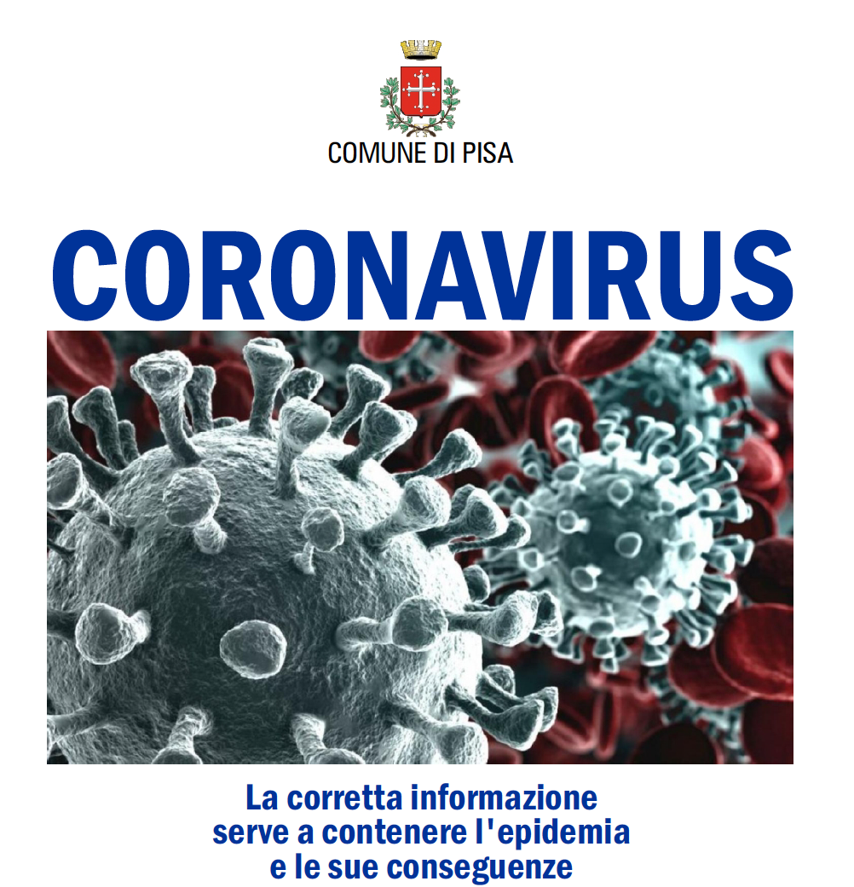

Slide 3
COVID-19: cenni di epidemiologia
In early December 2019 a patient was diagnosed with an unusual pneumonia in the city of Wuhan, China.
By December 31 the WHO regional office in Beijing had received notification of a cluster of patients with pneumonia of unknown cause from the same city.
Wuhan, the capital city of Hubei Province in central China, is the nation’s seventh largest city, with a population of 11 M.
Over the next few days, researchers at the Wuhan Institute of Virology performed metagenomics analysis using next-generation sequencing from a sample collected from a bronchoalveolar lavage and identified a novel coronavirus as the potential etiology.
They called it novel coronavirus 2019 (nCoV-2019).
The US CDC refers to it as 2019 novel coronavirus (2019-nCoV).

Slide 4
COVID-19: cenni di epidemiologia
As of February 12, 2020, more than 45 000 cases of 2019-nCoV have been reported, 99% of them in China, and the outbreak is linked to more than 1100 deaths.
As the epidemic is evolving and the situation is rapidly changing, up-to-date reliable information on the number of cases and recommendations on management of cases and preventive interventions can be found at various sites
Currently the number of infections outside of China remains small (approximately 400), but cases have been detected in 25 countries, including 43 cases in Europe

Slide 5
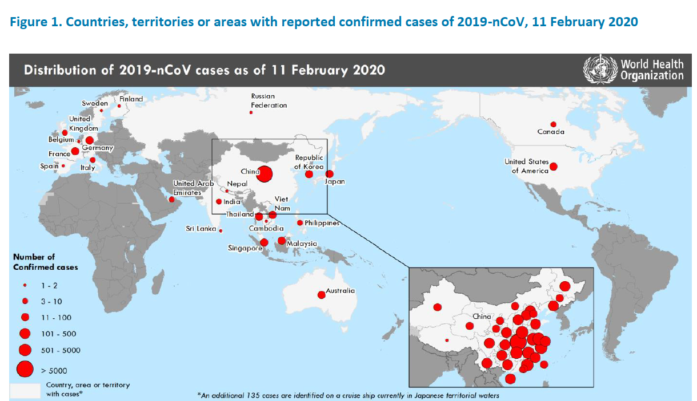
COVID-19: mappa generale

Slide 6
COVID-19
Prevalence of global cases and in China
Increase of 153 times from 21 gen to 11 feb

Slide 7
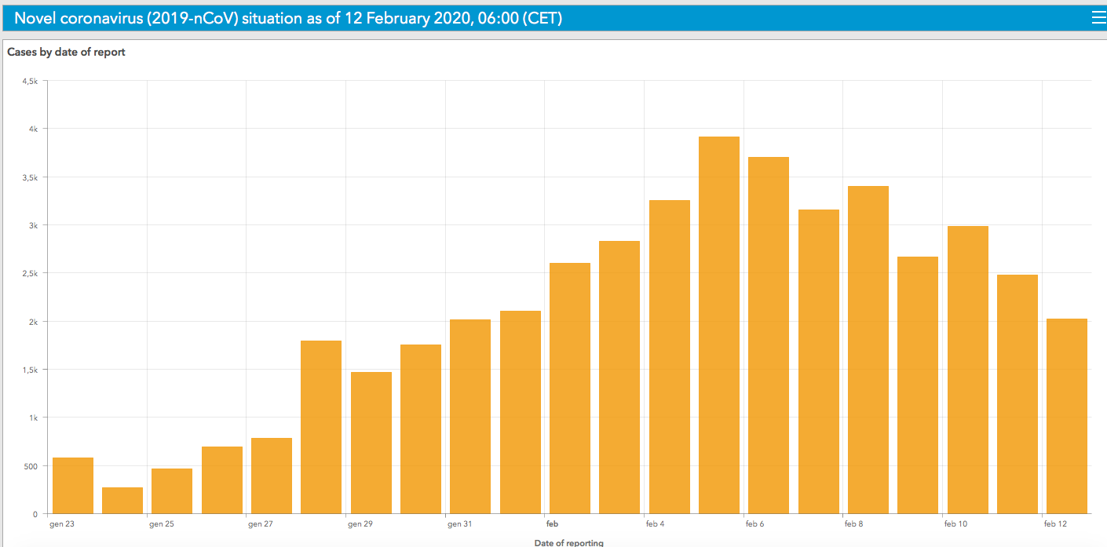
INCIDENZA DI NUOVI CASI DI COVID-19

Slide 8
COVID-19
Number of deaths
Mortaliy: 2.4%

Slide 9
COVID-19: global cases 45.195 12.02.2020
Overall deaths: 1116
outside China: 1

Slide 10
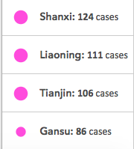

Slide 11
COVID-19
Prevalence in Europe

Slide 12
COVID-19
Prevalence in Europe and secondary transmission
23 cases with exposure outside of China:
12 Germany
6 France
3 UK
2 Spain
?

Slide 13
COVID-19
Cases in Europe for each country
8
3
16
11

Slide 14
COVID-19 in Europe
paese | n. casi | Casi autoctoni | decessi | note
Germania | 16 | 12 | 0
Francia | 11 | 6 | 0
Italia | 3 | 0 | 0
UK | 8 | 7 | 0 | 6 exposure outside of UK
Russia | 2 | 0 | 0
Spagna | 2 | 2* | 0 | The exposure for both case occurred outside of Spain
Finlandia | 1 | 0 | 0
Svezia | 1 | 0 | 0
Belgio | 1 | 0 | 0
Totale | 45 | 23 | 0

Slide 15
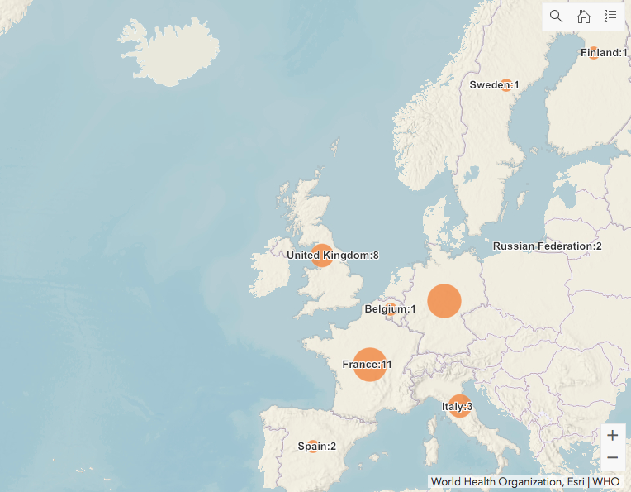
COVID-19 in Europe
Germany 16

Slide 16
COVID-19: cenni di epidemiologia
A modeling study suggests that as of January 25, 2020, 75 815 individuals have been infected in Wuhan alone.
The authors calculated the basic reproductive number (the number of cases one infected individual generates), R₀, of this outbreak to be 2.68 (95% CI, 2.47-2.86) and that the epidemic is doubling every 6.4 days.
Bangkok, Hong Kong, Singapore, Tokyo, and Taipei are the locations with the majority of cases outside of mainland China.
For now, it appears that compared with the other 2 zoonotic coronaviruses that occurred in the last 20 years (severe SARS in 2002 and MERS in 2012, 2019-nCoV seems to have greater infectivity (eg, a higher R₀) and a lower case fatality rate.

Slide 17
Pandemic potential of CoVID-19
An important determinant of whether or not 2019 novel coronavirus (2019-nCoV) will ultimately cause a global pandemic is its ability to become established upon its importation to a new country.
The key quantity governing whether or not 2019-nCoV can establish and generate a sustained outbreak on arrival in a new country is the reproduction number, R, which represents the average number of individuals that each infector will transmit the virus to.
If R is greater than 1, sustained transmission can occur; if R is less than 1, then chains of transmission will simply stutter out.

Slide 18
Pandemic potential of CoVID-19
In the ongoing outbreak, assuming an R of 2·2, then just over half of infections must be prevented to bring R below 1.
This might be expected to be challenging if 2019-nCoV can be transmitted when infectors are not symptomatic.
However, there is little evidence to suggest presymptomatic transmission of 2019-nCoV.2
Even if 20% of infections are occurring because of presymptomatic infectors, then 80% of infections would be due to symptomatic infectors.
Because only slightly more than half of infections need to be prevented to bring R below 1, effective isolation of symptomatic hosts alone should be sufficient to prevent sustained outbreaks of 2019-nCoV outside China.

Slide 19
Pandemic potential of CoVID-19
Of course, detection and isolation of symptomatic hosts is not always carried out effectively, and detection is challenging when symptoms are mild.
Therefore, efforts to counter presymptomatic transmission might sometimes be merited.
However, when implementing such measures (eg, the isolation of passengers returning from Hubei, infected or not), the substantial cost to individuals who might not be carrying the virus should be considered carefully.
With fast isolation of symptomatic individuals alone, including self-isolation of those with mild symptoms, sustained outbreaks outside of China can be prevented.
Robin Thompson robin.thompson@chch.ox.ac.uk
Christ Church, University of Oxford, Oxford OX1 1DP, UK

Slide 20
COVID-19: genetica e serbatoi animali
From genetic sequencing data, it appears that there was a single introduction into humans followed by human-to-human spread.
This novel virus shares 79.5% of genetic sequence with SARS-CoV and has 96.2% homology to a bat coronavirus.
2019-nCoV shares the same cell entry receptor, ACE2, with SARS-CoV.
What is yet unclear is which animal is the intermediate species between bats and humans.
For SARS it was civet cats, for MERS it is camels. While the source of 2019-CoV is yet unknown, early on the Huanan Seafood Wholesale Market was linked epidemiologically.

Slide 21
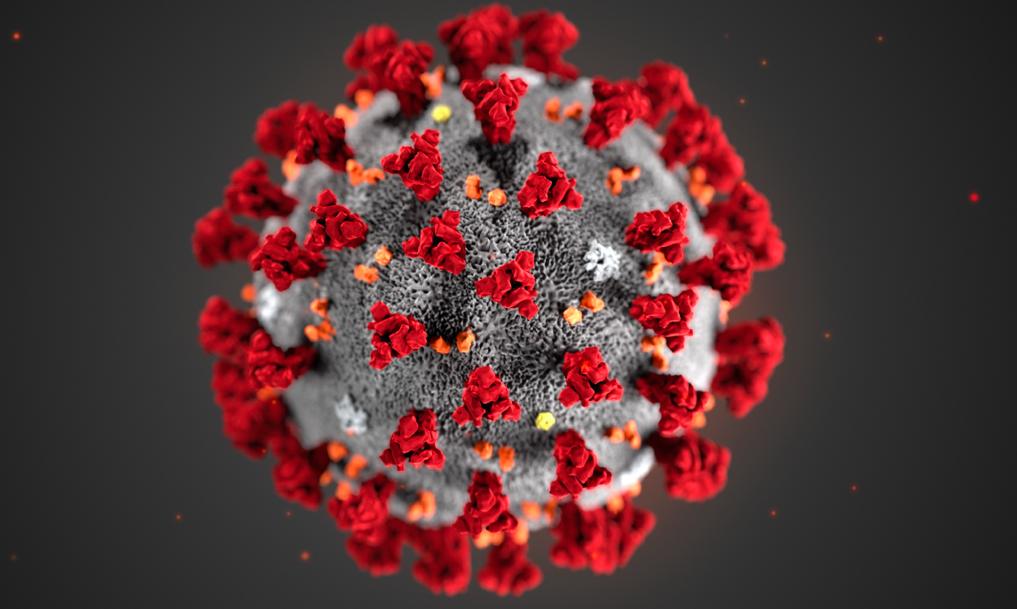
COVID-19: electron microscopy

Slide 22
The pathogens
Coronaviruses are enveloped positive stranded RNA viruses
The virions have a crown-like appearance under the electron microscope
The subfamily Orthocoronavirinae is classified into four coronavirus (CoV) genera: Alpha-, Beta-, Delta- and Gammacoronavirus.
Coronaviruses are known to infect humans and a variety of animals (including birds and mammals).
Epithelial cells in the respiratory and gastrointestinal tract are the primary target cells.
Viral shedding occurs via these systems and transmission can occur through different routes: fomites, airborne or faecal-oral.

Slide 23
The pathogens
Seven coronaviruses infect humans.
Human Betacoronavirus OC43 and HKU1 and Alphacoronavirus 229E cause common colds but also severe LRTI infections in the youngest and oldest age groups
Alphacoronavirus NL63 is considered to be an important cause of (pseudo) croup and bronchiolitis in children
Additional zoonotic coronaviruses have emerged and caused outbreaks in humans: SARS-CoV (2002,Sarbecovirus), and MERS-CoV (2012 Merbecovirus).
In late 2019, a novel coronavirus related to a cluster of pneumonia cases in Wuhan, China (2019-nCoV) was identified.
The 2019-nCoV is closely related to SARSCoV and genetically clusters within Betacoronavirus subgenus Sarbecovirus

Slide 24
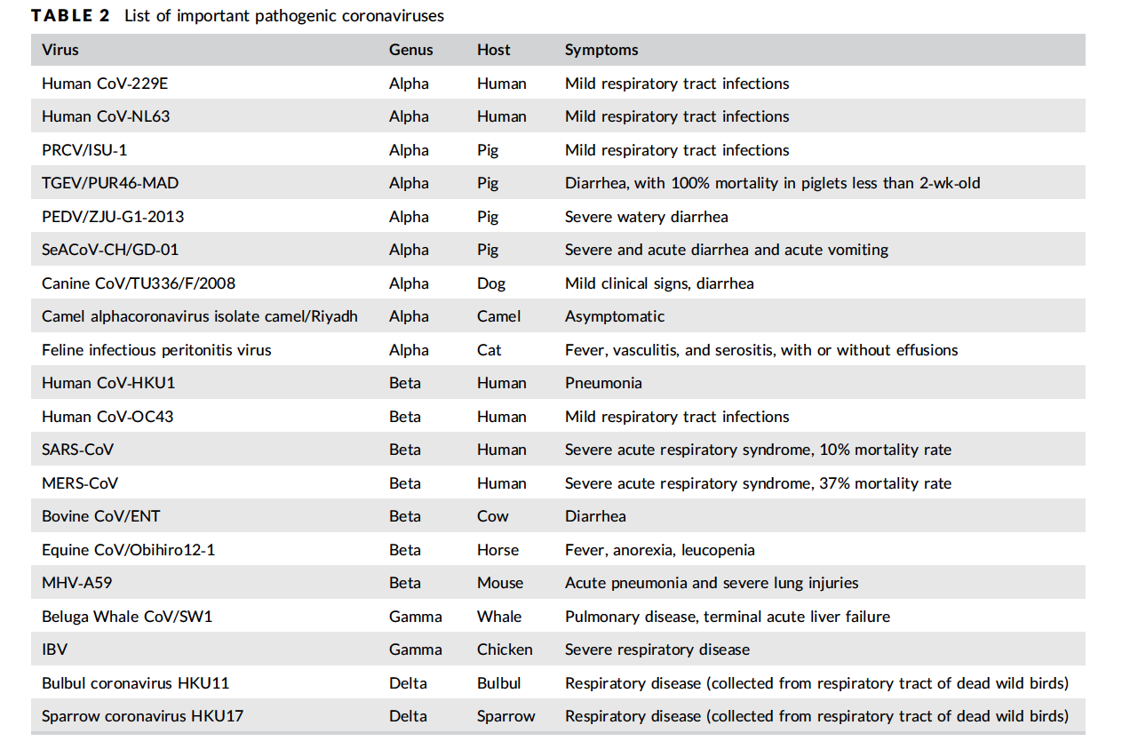

Slide 25
COVID-19: cenni di virologia
Zhu et al. have identified and characterized 2019-nCoV.
2019-nCoV grows better in primary human airway epithelial cells than in standard tissue-culture cells, unlike SARS-CoV or MERS-CoV.
Knowing the sequence of the genome facilitated the development of sensitive quantitative RT-PCR assays
The development of serologic assays will allow assessment of the prevalence of the infection in humans and in potential zoonotic sources of the virus in wet markets and other settings.

Slide 26
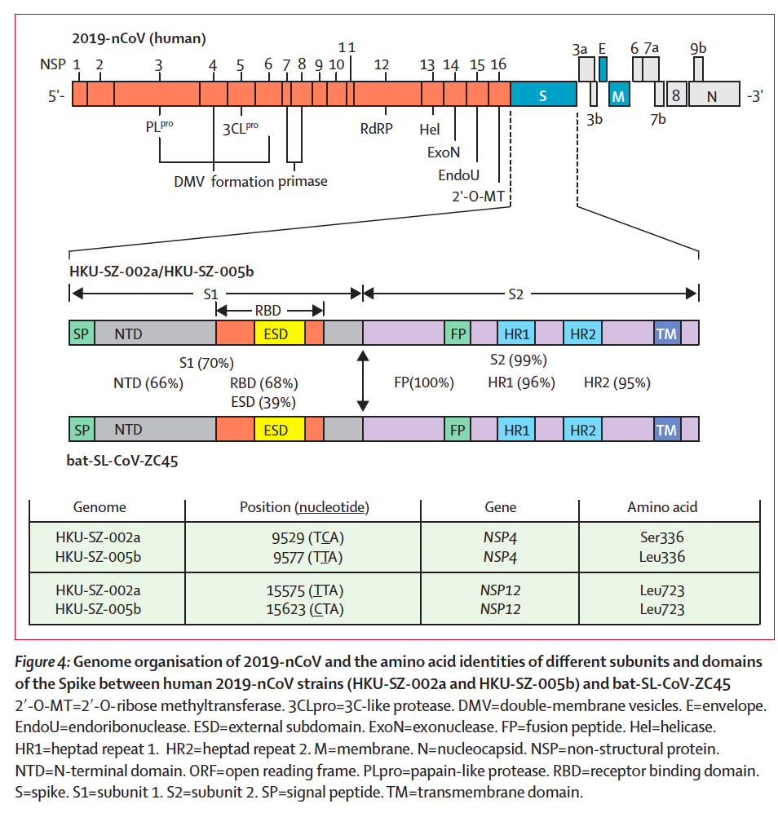

Slide 27
COVID-19: incubazione e trasmissibilità
The incubation period of this virus has been reported to be 5.2 days (95% CI, 4.1-7.0), although there is suggestion that it may be as long as 14 days.
It is unclear when transmission begins and, although cases have been reported that suggest transmission during the asymptomatic phase, it is likely that the majority of secondary cases come from symptomatic individuals.

Slide 28
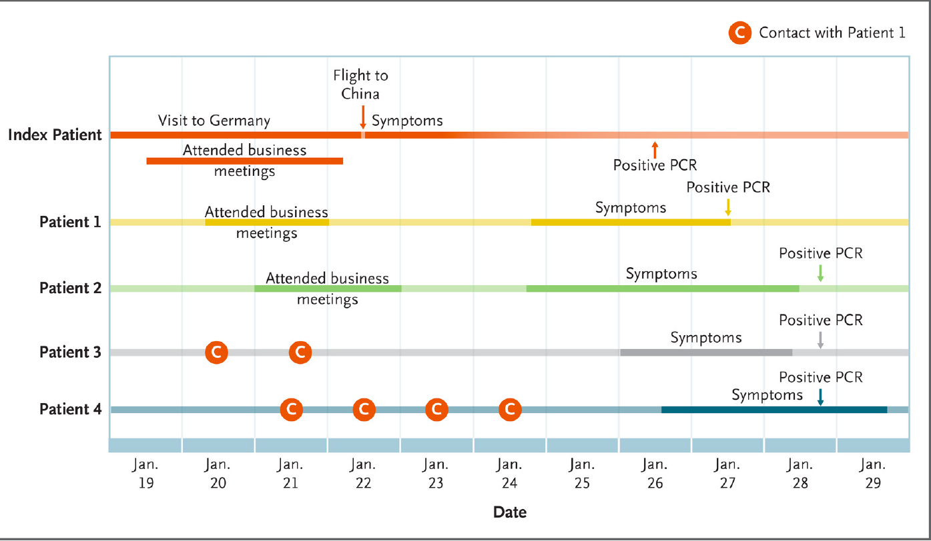

Slide 29
COVID-19: clinical pictures
Clinical syndrome is nonspecific: fever and dry cough, shortness of breath (30%)
Some patients have myalgias, headache, sore throat, and diarrhea.
The median age of patients is between 49 and 56 years.
Cases in children have been rare.
Most cases appear to be mild, all pts admitted to the hospital have pneumonia with infiltrates on chest x-ray and ground glass opacities on chest CT
About a third of pts subsequently developed ARDS and required care in the ICU.
This is particularly true for patients with comorbid conditions such as diabetes or hypertension.

Slide 31
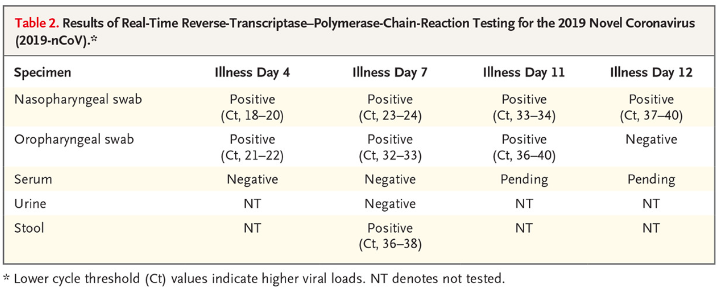
Our case patient initially presented with mild cough and low-grade intermittent fevers, without evidence of pneumonia on chest radiography on day 4 of his illness, before having progression to pneumonia by illness day 9. The timing of our case patient’s progression to pneumonia on day 9 of illness is consistent with later onset of dyspnea (at a median of 8 days from onset) reported in a recent publication.

Slide 32
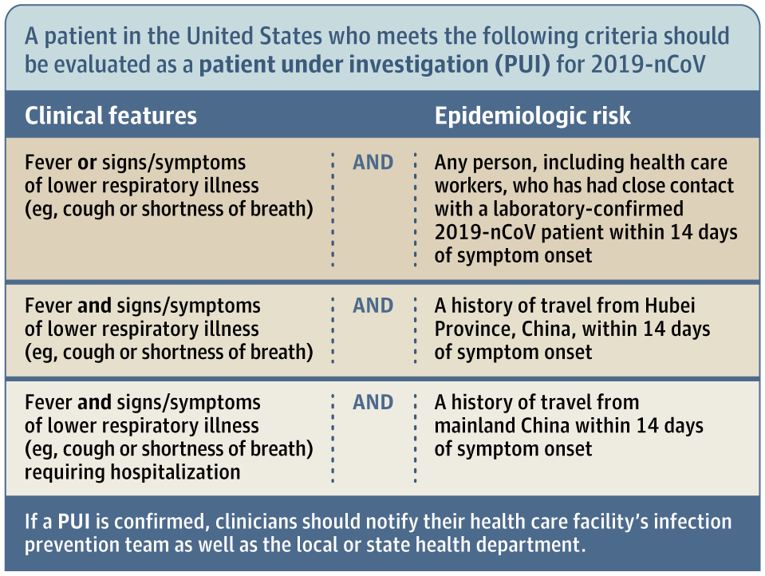
From: 2019 Novel Coronavirus—Important Information for Clinicians
JAMA. Published online February 05, 2020. doi:10.1001/jama.2020.1490
Figure Legend:
Criteria to Guide Evaluation of Patients Under Investigation for 2019 Novel Coronavirus (2019-nCoV)Adapted from the CDC.

Slide 33
CoVID-19: patient under investigation
When a patient presents with fever and respiratory symptoms (in particular a dry cough), clinicians should obtain a detailed travel history.
If the patient has a history of travel to Hubei Province in the last 14 days, they should be considered a person under investigation
Diagnostic testing for 2019-nCoV is conducted in Pisa (Siena) and confirmed at ISS
Clinicians should test for other respiratory pathogens and consider prescribing oseltamivir pending results of influenza testing.
When there is a high degree of suspicion that a patient might have 2019-nCoV, they should have a face mask placed immediately and health care practitioners should wear N95 respirators.

Slide 34
CoVID-19: potential therapies
Remdesivir: questo farmaco è in sperimentazione sull’uomo contro le infezioni da Ebola, e nei test in vitro ha mostrato una certa attività anche contro coronavirus come Sars e Mers. E’ stato utilizzato sul primo paziente infetto dal nuovo coronavirus negli Usa
Lopinavir e Ritonavir: la combinazione di questi due farmaci anti Hiv è stata usata nel 2004 durante l’epidemia di Sars, ed è in sperimentazione su 41 pazienti in un ospedale di Wuhan, insieme ad una dose di interferone alfa.
Clorochina: questo farmaco antimalarico è in uso da oltre 70 anni, e recentemente la Commissione Sanitaria Nazionale Cinese lo ha indicato tra quelli che hanno un’attività in vitro contro il nuovo coronavirus su cui proseguiranno i test.
Umifenovir e Darunavir: il primo è un antinfluenzale, mentre il secondo è un farmaco anti Hiv già in uso da diversi anni. Entrambi avrebbero mostrato un’attività contro il virus in vitro.

Slide 36
CoVID-19: riflessioni conclusive
What interventions will ultimately control this outbreak is unclear because there is currently no vaccine, and the effectiveness of antivirals is unproven.
However, basic public health measures such as:
staying home when ill,
handwashing, and
respiratory etiquette including covering the mouth and nose during sneezing and coughing
were effective in controlling SARS.

Slide 37
CoVID-19: riflessioni conclusive
As a new outbreak confronts frontline clinicians and public health authorities, these groups must work together to educate the public by providing accurate and up-to-date information and by taking care of patients with respiratory illness in a timely and effective way.

Slide 38
